Slide 1
Survival Analysis Study in Pancreatic Ductal Adenocarcinoma Patients
Group 7: Jingyiran Li, Lily Xia, Simran Samra and Hassan Ali
Notes:
Hello everyone.

Slide 2

Pancreatic Ductal Adenocarcinoma (PDAC)
PDAC is the most prevalent form of pancreatic cancer
Pancreatic cancer is highly aggressive as 80-90% of patients present with surgically unresectable disease (Oettle H et al. 2007)
There is a lack of clinically actionable biomarkers (Pancreatic Cancer Action Network)
Response to treatment is poor (Pancreatic Cancer Canada)
Pancreatic cancer will soon be the third leading cause of cancer death in Canada (Pancreatic Cancer Canada)
LESS THAN 10%
The 5-year survival rate for for pancreatic cancer remains less than 10%
(SEER Cancer Stat Facts: Pancreas Cancer)

Slide 3

Pancreatic Ductal Adenocarcinoma (PDAC)
One of the principal problems facing PDAC is heterogeneity
Despite tremendous scientific research, survival rates have not changed much during the last 20 years
Taking this information into account, we developed this current project to perform a survival analysis in patients with pancreatic ductal adenocarcinoma

Slide 4
Aim of Project
Our goal was to examine the relationship between gene expression level and vital status
Hypothesis
Certain genes are more heavily expressed in PDAC patients that survive while other genes seem to associate with PDAC patients that do not survive
Biological Relevance
Characterizing amplified gene targets/pathways enables us to identify ideal chemotherapeutic drug candidates and create a tailored therapy regimen

Slide 5

Dataset
Our hypothesis was investigated using the TCGA-PAAD dataset from The Cancer Genome Atlas, and it contains:
The expression of 44,084 genes from 177 resected tumors of patients suffering from PDAC
Subject demographics, including, sex, age, race, vital status, and other survival-related information
No control subjects since this dataset only reflects cancer patients’ genome

Slide 6
Our Workflow
1
Data description and wrangling
Exploratory data analysis
Expression analysis using LIMMA
Feature selection (genes) using PCA and LASSO
Classification analysis (alive or deceased)
Survival analysis
2
3
4
5
6

Slide 7
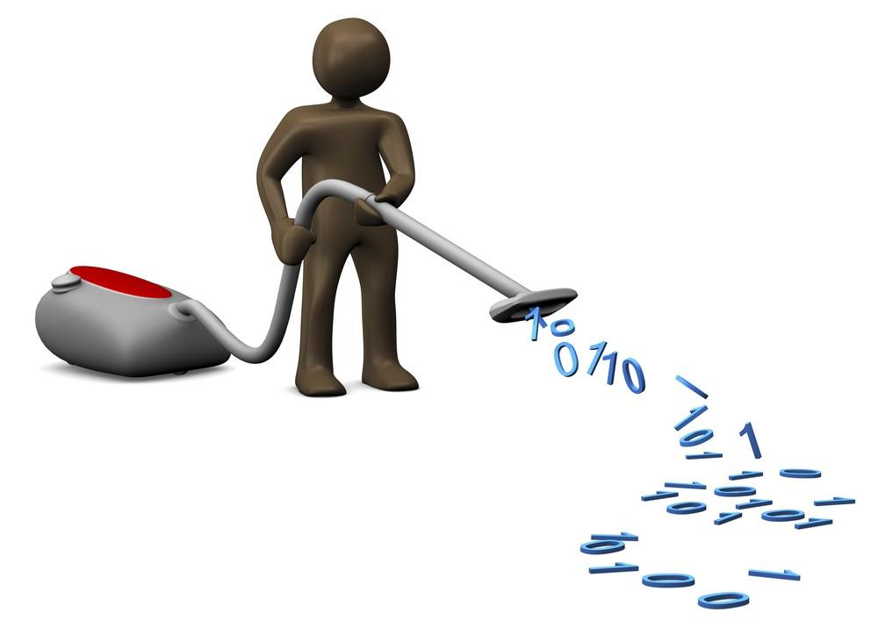
Data Description and Wrangling
Sample clinical data had multiple unfilled columns, and they were removed
We mainly focused on patients’ age, sex, race, tumor stages, treatments, survival time and vital status
To allow for comparability of the effects of these on gene expression, expression data was standardized to generate heatmaps

Slide 8
Data Description and Wrangling
COVARIANTES INCLUDED IN META-DATA
American Joint Committee on Cancer (AJCC)
AJCC Pathologic T Tumor Size
AJCC Pathologic N Lymph Node Involvement
AJCC Pathologic M Presence of Metastasis
AJCC Pathologic Stage Extent of Cancer Progression
Age At Index,
Year of Birth / Death / Diagnosis
Vital Status
Race
Sex
Stage IA Least Severe
Stage IB
Stage IIA
Stage IIB
Stage III
Stage IV Most Severe

Slide 9
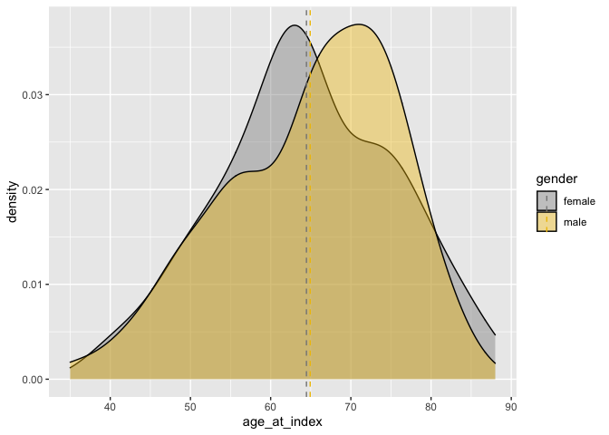
Exploratory Data Analysis (EDA)
EDA was performed to visualize features and relationships of the covariates
This density plot shows that the mean age of females and males at the time of index was similar (~66 years old)

Slide 10
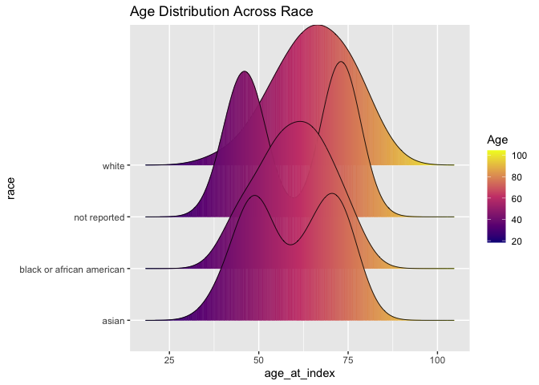
Exploratory Data Analysis
This density plot shows the distribution of age across race
Majority of the patients were caucasian, then African American and then Asian
A portion of the patients did not provide their race

Slide 11
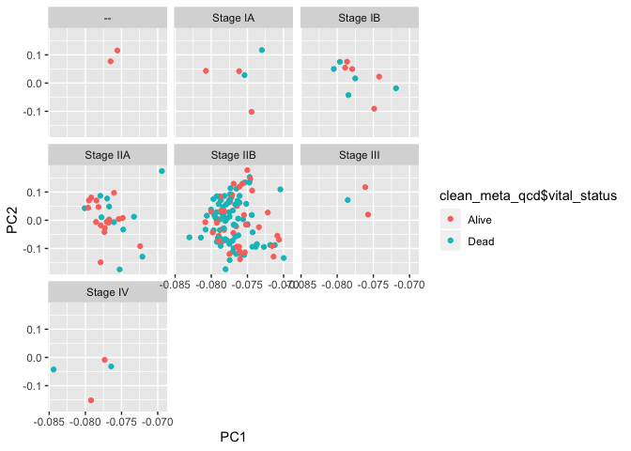
Exploratory Data Analysis
Principal component analysis for top 5000 genes reveals:
There does not seem to be an effect of vital status on gene expression
A majority of the tumors were at stage IIB
Cancer is confined to the pancreas, and it has spread to at most 3 nearby lymph nodes

Slide 12
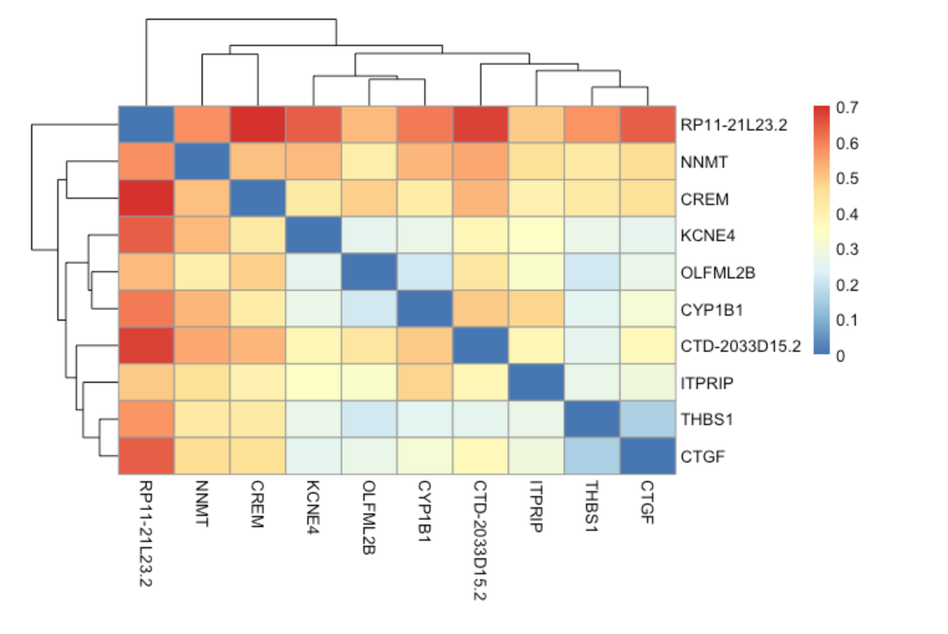
Expression Analysis using LIMMA
The top 10 most influential genes on the vital status of cancer subjects were determined using limma and empirical Bayes
This heatmap shows correlation among these top 10 genes

Slide 13
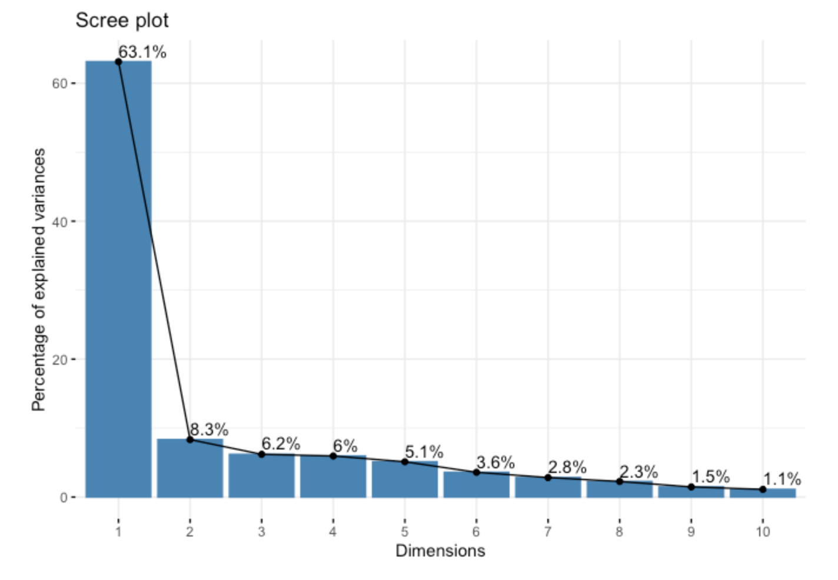
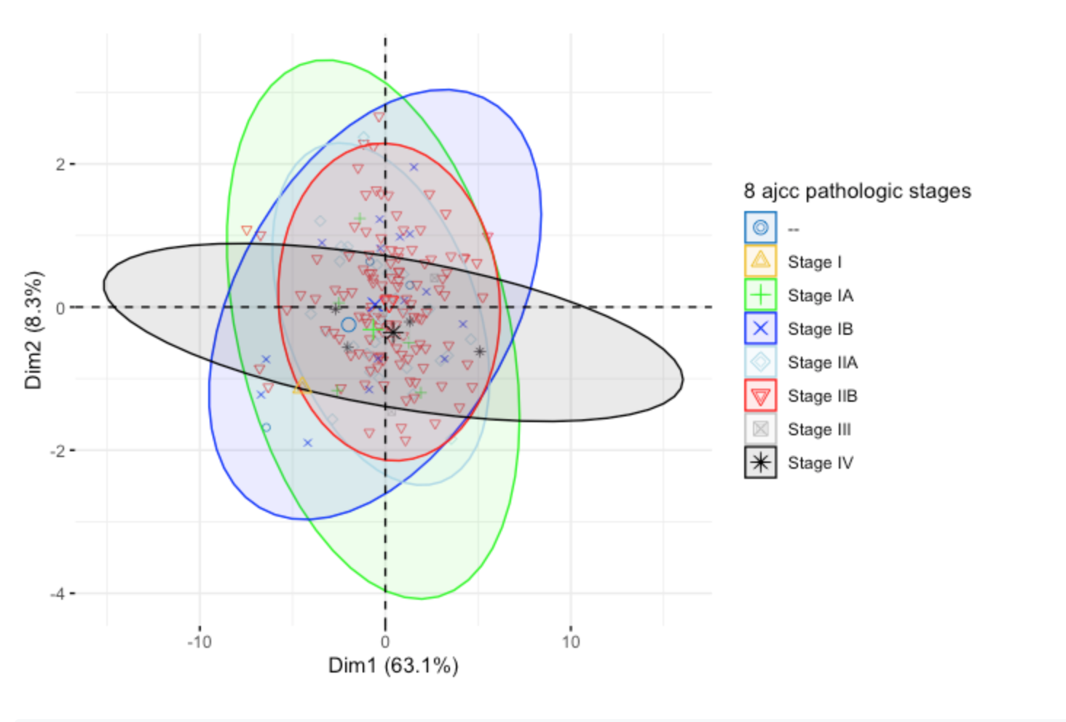
Principal Component Analysis
(PCA)
PCA was conducted among the top 10 genes
~ 63% of the variation was due to the first component and ~ 8.3% was due to the second component
The first two components are able to explain ~ 70% variation of the total [Figure A]
Pathologic stages were also clustered based on principal components 1 and 2 [Figure B]
A
B
Notes:
In top 10 genes

Slide 14
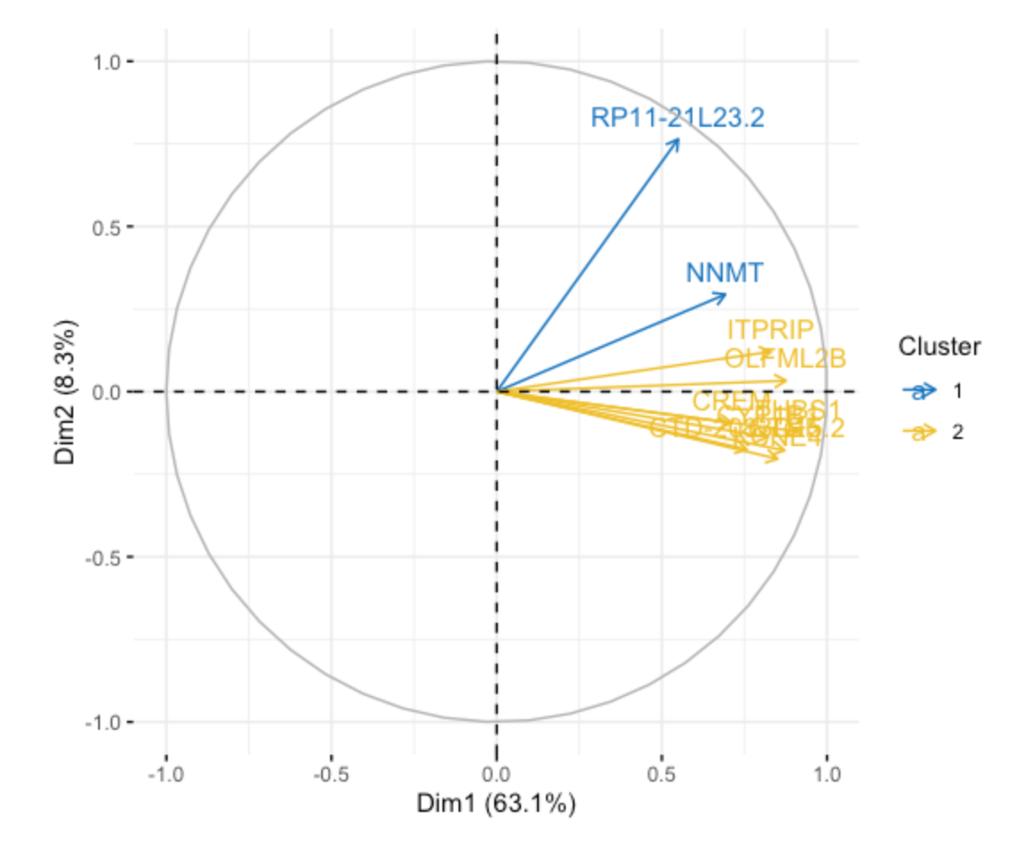
Principal Component Analysis
We clustered the top 10 genes using k-mean algorithm with k equal to 2
Two clusters of genes were plotted in 2D PC coordinate system

Slide 15
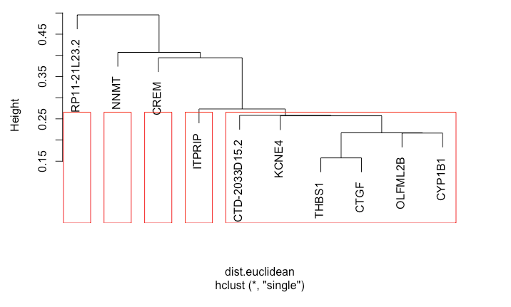
Classification of Gene Expressions
A hierarchical dendrogram for the top ten genes
Euclidean was used as sample distance and single linkage criteria was used to represent the clusters’ distance
The expression of the top 10 genes among samples was not well separated using the mentioned clustering criteria, and we might try ‘correlation’ instead of Euclidean distance in future

Slide 16
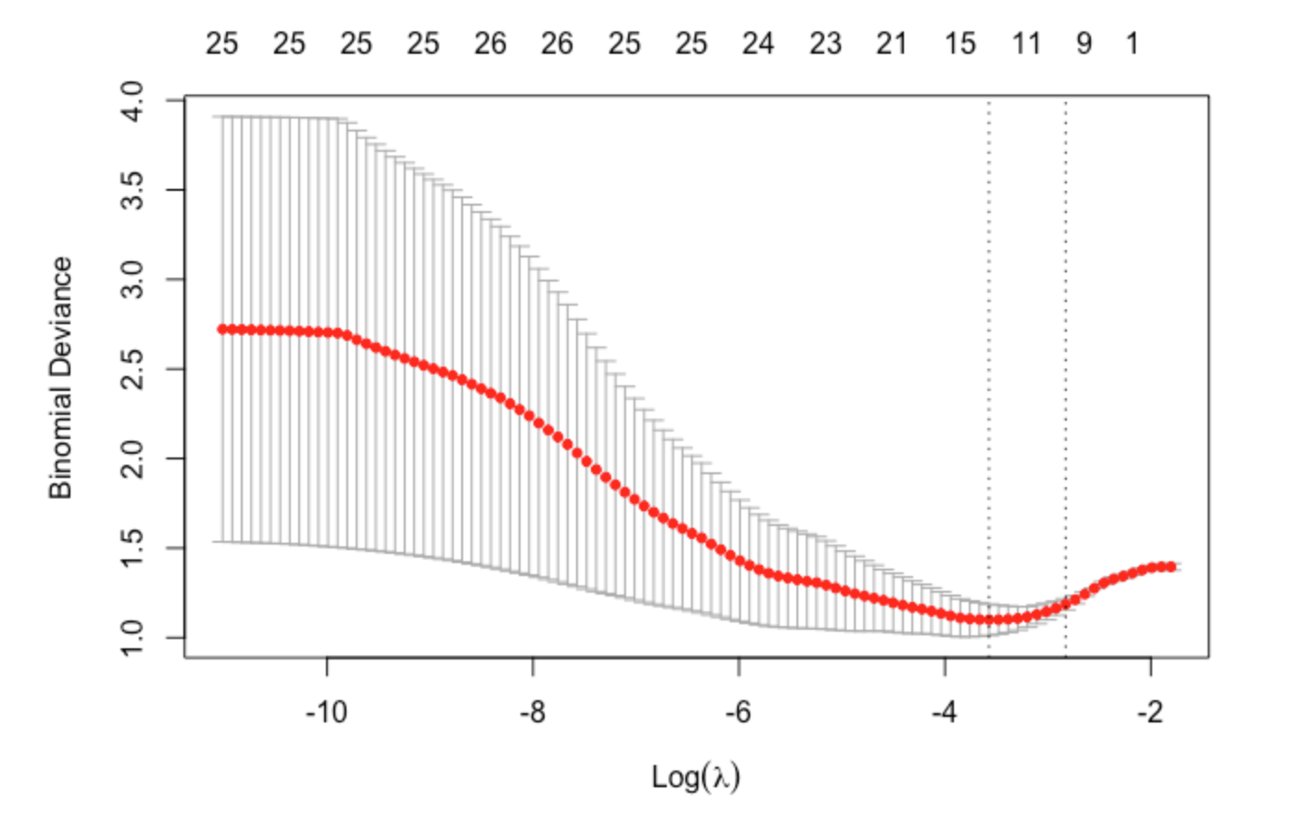
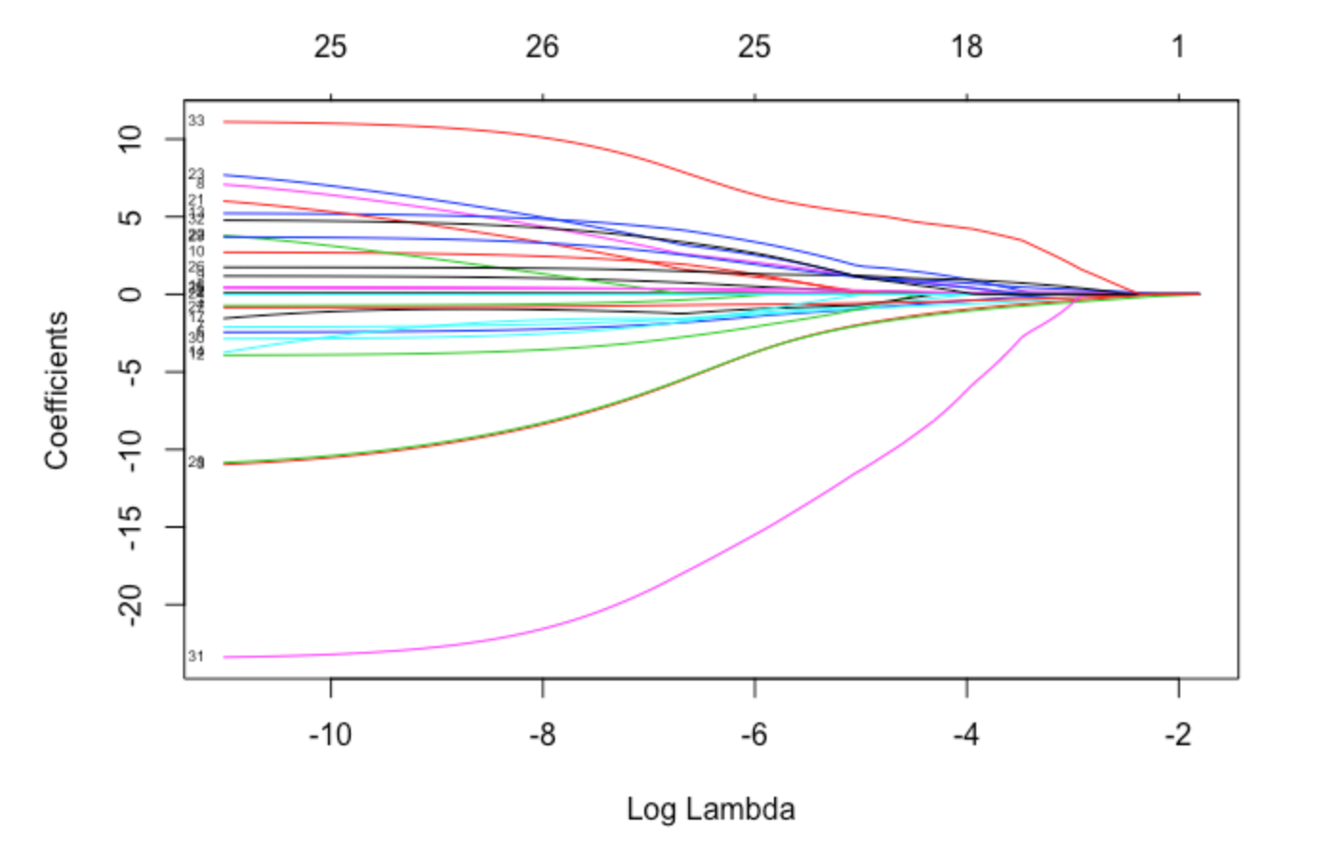
Lasso Selection
A generalized linear model
As lambda increases, more coefficients are set to zero and among non-zero coefficients, more shrinkage is employed
Used for feature selection
The most important variables selected based on LASSO are age_at_index, year_of_diagnosis, race, gender, pathologic T, N, and M, pathologic stage, survival time, THBS1, CREM, and RP11.

Slide 17
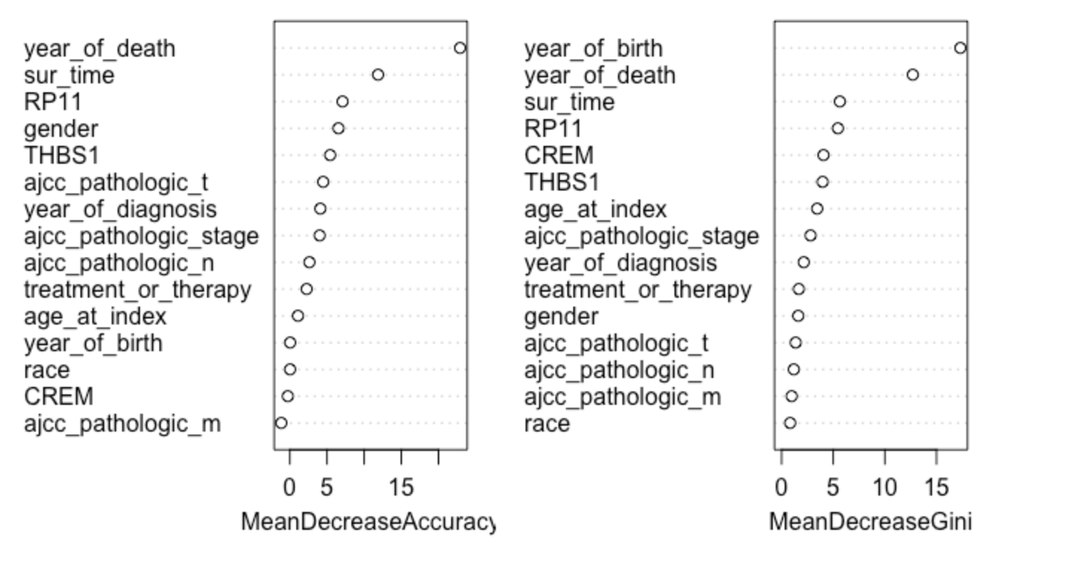
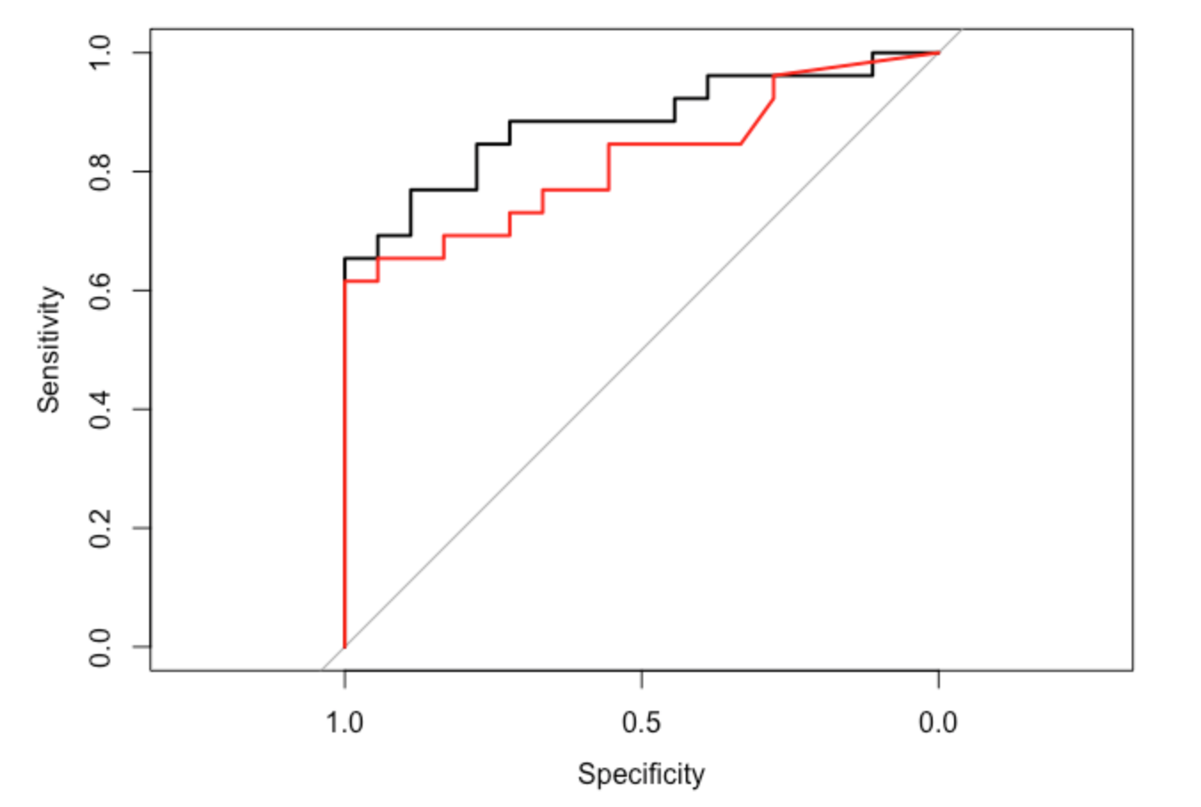
Classification of Vital Status
An ensemble classifier used to obtain variability
Relative importance of each attribute generated [Figure A]
Sensitivity vs specificity of classifier obtained
The accuracy for the random forest algorithm is 70% while that for the AdaBoost algorithm is 73%. The AUC for the random forest is 0.8825 while that for AdaBoost is 0.8194.
Both algorithms yielded similar results [Figure B]
A
Random Forest
AdaBoost
B

Slide 18
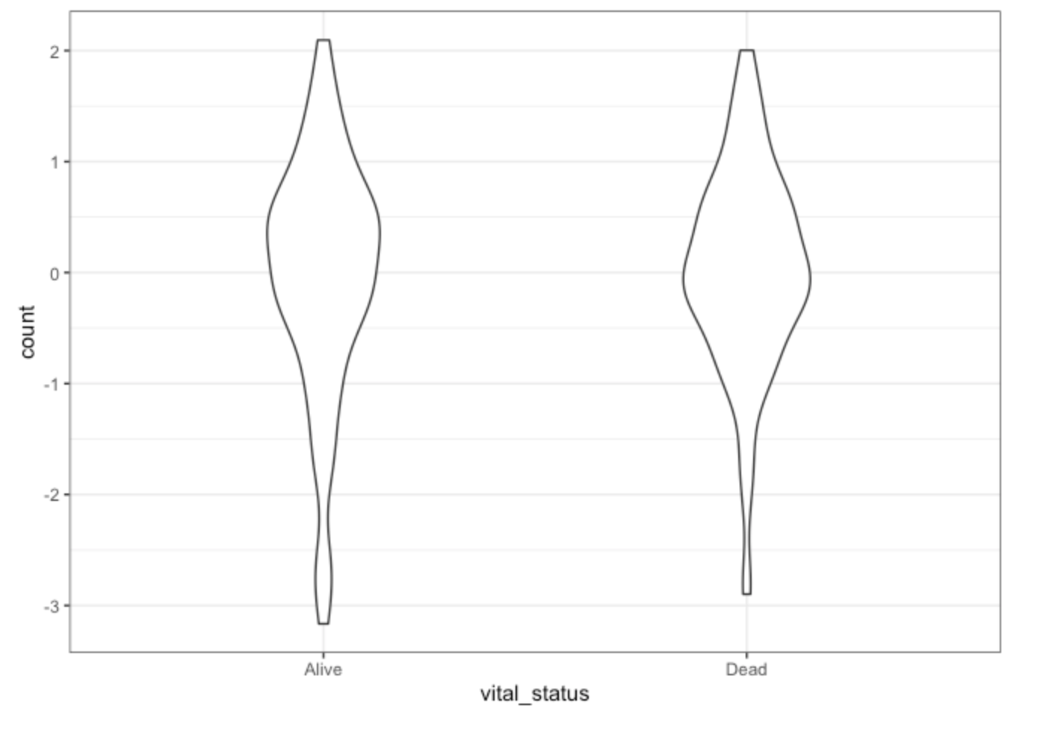
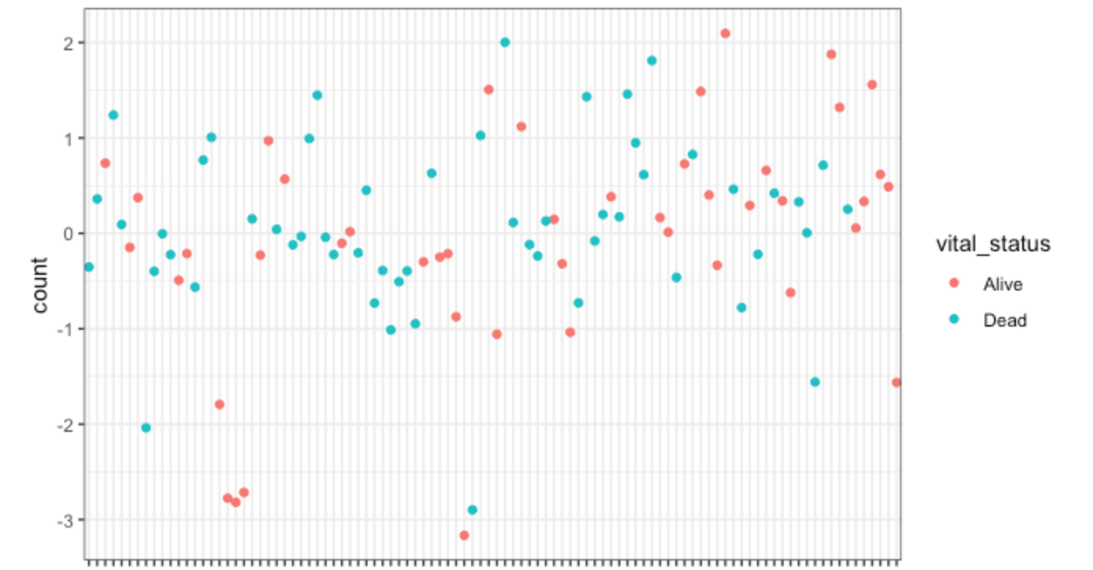

Comparison of Vital Status
Top 10 genes were compared using violin plot and two-sample t-test [Figure A]
Null hypothesis: there is no gene expression difference between vital status of cancer subjects
A comparison of alive and dead gives a p-value of 0.70
We failed to reject the null hypothesis at the 0.05 significance level
No clear majority visible from scatter plot [Figure B]
A
B

Slide 19
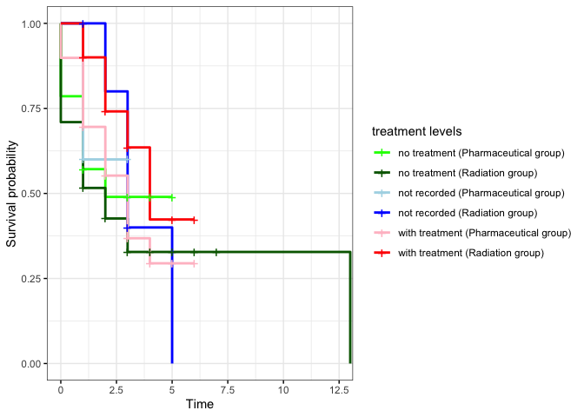
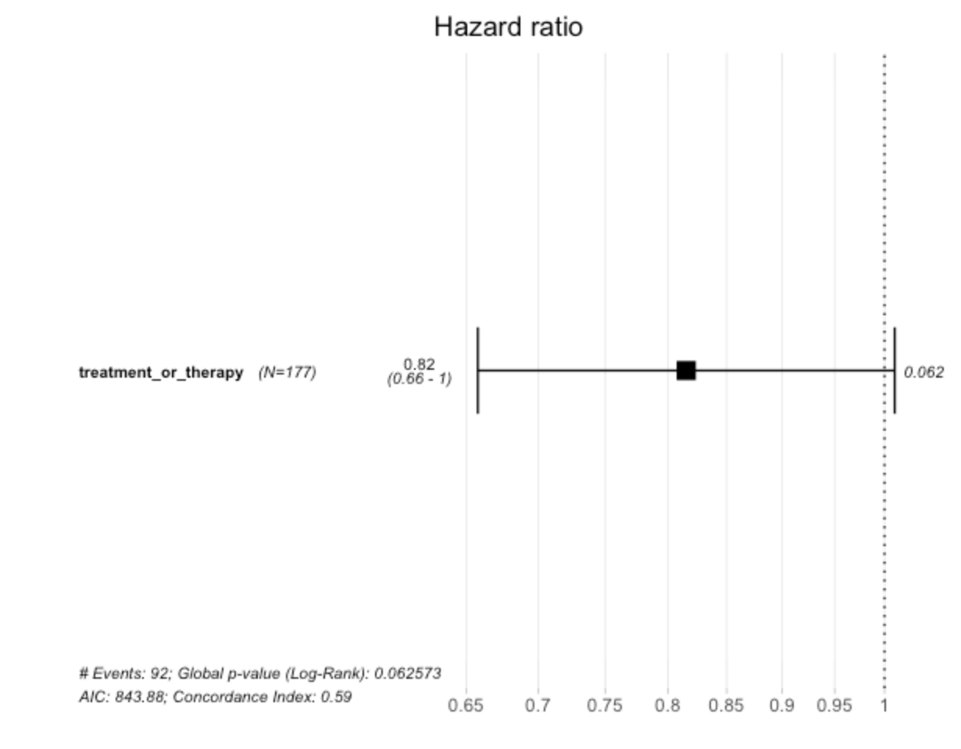
Survival Analysis
Kaplan-Meier estimators of the survival functions for six treatment groups are shown [Figure A]
No survival differences in:
No treatment pharm group versus treatment pharm group
No treatment pharm versus no treatment radiation
Not recorded pharm and radiation groups
Survival differences in:
With treatment pharm and radiation groups
No treatment radiation and with treatment radiation groups
Not recorded pharm group and with treatment radiation group
A
B

Slide 20
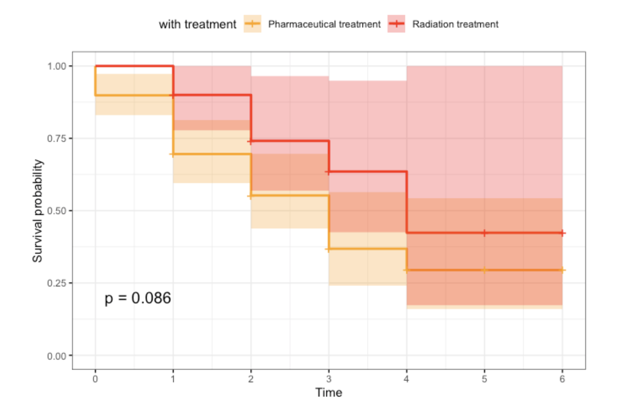
Survival Analysis Continued
Subtle differences exist between radiation and pharmaceutical treatments
Radiation yields a slightly better survival
Log rank test with a borderline p-value

Slide 21
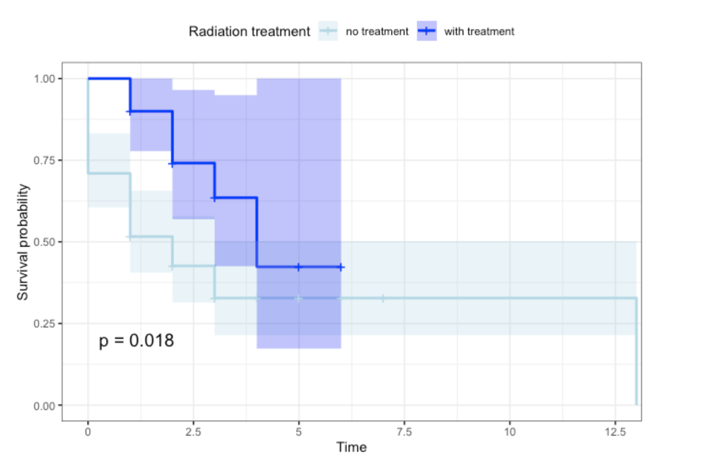
Survival Analysis Continued
A significant improvement in survival when subjected under radiation treatment
However, the confidence bands overlap
Unstable estimates with larger S.E. towards the end of the censoring period

Slide 22
Summary
The top 5 genes selected using limma, ebayes, and a correlation heatmap are THBS1, NNMT, CREM, ITPRIP, and RP11.
The most important variables selected based on LASSO are age_at_index, year_of_diagnosis, race, gender, pathologic T, N, and M, pathologic stage, survival time, THBS1, CREM, and RP11.
The first principal component captures 63.1% of the total variance, and the second principal component explains 8.3% variance from the remaining variation.
Compared projected gene expression points of samples’ vital status
The concentration ellipses of alive and dead are greatly overlapping
Gene expression does not differ

Slide 23
Summary Continued
The accuracy for the random forest algorithm is 70% while that for the AdaBoost algorithm is 73%. The AUC for the random forest is 0.8825 while that for AdaBoost is 0.8194.
No significant difference in subjects’ top gene expression.
Based on the Kaplan Meier plot, the three group does not show a significantly different survival rate. A Log-rank test with a p-value of 0.2 further confirmed that there’s no difference in survival rate among the groups: treatment, therapy, and not reported.
Higher survival rate for radiation treatment group

Slide 24
Limitations of our Project and Future Work
The real challenge is that we could not find the target genes from the top 10 genes
One possibility is that the target genes were not in the top 10 genes in the first place
Positive and negative effects that they impose on patients’ survival could be canceled out
A lack of mutational signature data further limited our ability to accurately predict target genes
The classification accuracy for both random forest and AdaBoost is semi-optimal
An optimization strategy for both algorithms should be explored.
Stratification should be employed to group subjects based on baseline covariates
Stratification is not possible with the current set of covariates because they cannot serve as cluster factors
Genes may not directly affect survival time, hence making it difficult to pinpoint target genes solely based on the outcomes of interest - survival time and vital status

Slide 25
Thank You For Listening To An Update Of Our Work
Group 7: Genome Surfers
Jingyiran Li, Lily Xia, Simran Samra and Hassan Ali
Notes:
Hello everyone.

